Slide 1

ATMOSPHERIC CORROSION
OF
CONCRETE STRUCTURE
Dr G H Thanki
Director & Principal Consultant
Corrosion Control & Monitoring Consultancy
Vadodara
www.corrosionawreness.com
Lecture delivered as course leader
During Two day Programme on
“Advanced Corrosion Management 2014”
Mumbai on 30th & 31st Jan 2014
Organized by
Indian Knowledge Center

Slide 2
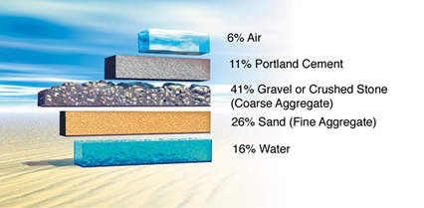
In its simplest form, concrete is a mixture of paste and aggregates. The paste, composed of Portland Cement and water, coats the surface of the fine and coarse aggregates. Through a chemical reaction called hydration, the paste hardens and gains strength to form the rock-like mass known as concrete.

Slide 3
Decay of Infrastructure
One of the significant problems facing the world today is the decay of their infrastructure
A major component of this decay is the degradation of bridges and highways by corrosion of the embedded reinforcing steel.
Through proper design,
this problem can be minimized and life expectancies dramatically increased in new structures.

Slide 4
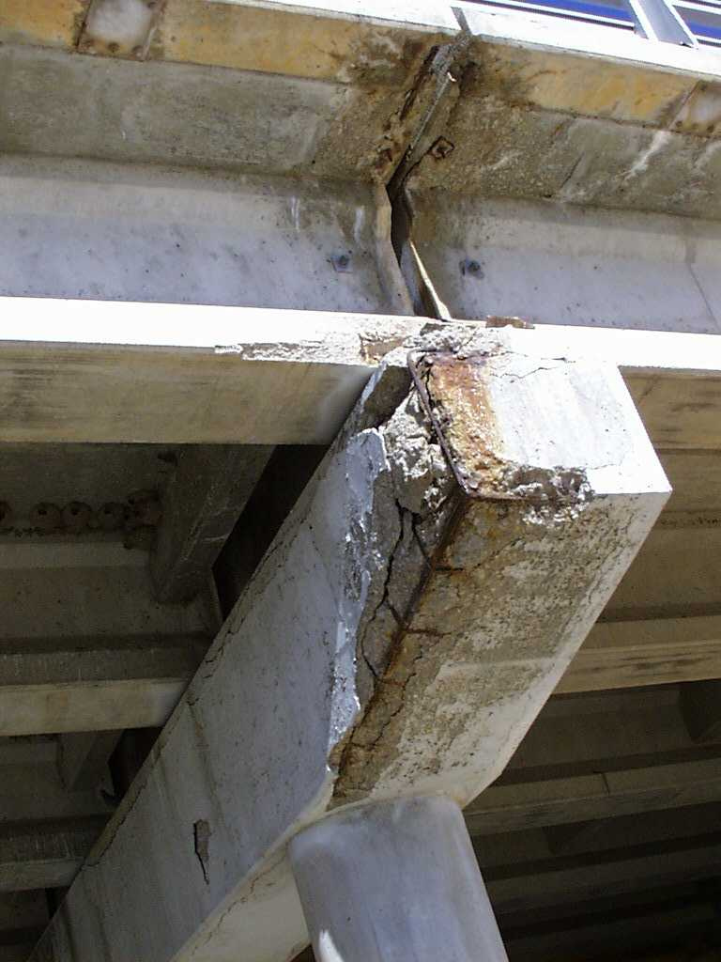
Corrosion Damage
Reinforced Concrete Bridge
volumetric increase of iron to rust causes internal pressures in the concrete, which leads to cracking and spalling of the concrete cover

Slide 5
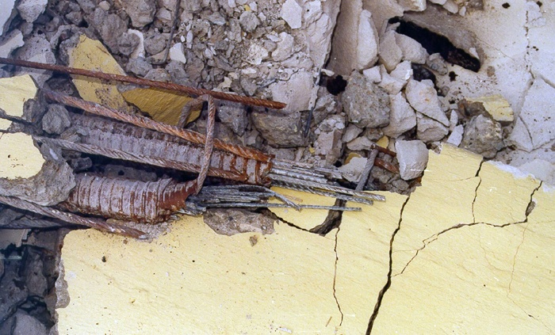
Cracked Prestressed Steel

Slide 6
Decay of Infrastructure
‘2005 Report card for America’s Infrastructure’, detailed the results of an evaluation study by ASCE on the condition of roads, bridges, transit systems and a variety of other structures.
Providing each category with a grade A through F, A being best and F being worst, ASCE gave U.S. infrastructure an overall score of D

Slide 7









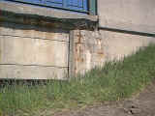



Reinforcing Steel Corrosion

Slide 8
Corroded Reinforcing Steel Concrete

Slide 9
Nature of the Problem
In concrete, the presence of abundant amount of calcium hydroxide and relatively small amounts of alkali elements, such as sodium and potassium, gives concrete a very high alkalinity-with pH of 12 to 13.

Slide 10
Nature of the Problem
This high alkalinity transforms surface layer of the embedded steel to a tightly adhering film.
As long as this film is not disturbed, it will keep the steel passive
and
protected from corrosion.

Slide 11
Nature of the Problem
When a concrete structure is often exposed to salt splashes, salt spray, or seawater,
chloride ions from these will slowly penetrate into the concrete
Mostly through the pores in the
hydrated cement paste

Slide 12
Nature of the Problem
The chloride ions will eventually
reach the steel
and then accumulate to beyond a certain concentration level,
at which the protective film is destroyed and the steel begins to corrode
in the presence of
oxygen and moisture at the steel-concrete interface

Slide 13
Nature of the Problem
In 1962, it was reported that the required minimum concentration of chloride in the concrete immediately surrounding the steel to initiate corrosion, the chloride corrosion threshold is 0.15% soluble chloride, by weight of cement.
In typical bridge deck concrete with a cement factor of 7, this is equivalent to 0.025% soluble chloride, by weight of concrete, 0.59 kg soluble chloride per cubic meter of concrete.
FHWA laboratories estimated the corrosion threshold to be 0.033% total chloride, by weight of concrete

Slide 14
Chloride Corrosion Threshold
The chloride corrosion threshold can vary between concrete in different bridges, depending on the type of cement and mix design used, which can vary the concentrations of
Tricalcium Aluminate (C3A) and
Hydroxide Ion (OH¯) in the concrete

Slide 15
Chloride Corrosion Threshold
It is more appropriate to express chloride corrosion threshold in terms of the ratio of chloride content to hydroxide content [Cl¯] / [OH¯],
which is established between 2.5 to 6.

Slide 16
Carbonation
Corrosion can also occur even in the
absence of chloride ions.
For example
The concrete comes into contact with carbonic acid resulting from carbon dioxide in the atmosphere.
The consequent carbonation of the calcium hydroxide in the hydrated cement paste leads to reduction of the alkalinity,
to pH as low as 8.5
This accelerate corrosion of embedded steel.

Slide 17
Carbonation
The rate of carbonation in concrete is
directly dependent on
the water/cement ratio (w/c) of the concrete –
the higher the ratio the greater is the depth of carbonation in the concrete.
In concrete of reasonable quality -
that is properly consolidated and has no cracking- the expected rate of carbonation is very low.

Slide 18
Carbonation
Concrete with w/c of 0.45
and
concrete cover 25 mm,
it will require more than 100 years for carbonation
to reach the concrete immediately surrounding the steel

Slide 19
What is Corrosion of Steel?
ASTM Terminology (G15) defines corrosion as
‘The chemical or electrochemical reaction between a material, usually a metal, and its environment that produces a deterioration of the materials and its properties’

Slide 20
What is Corrosion of Steel?
Steel embedded in concrete,
corrosion results in the formation of rust which has 2 to 4 times the volume of the original steel and poor mechanical properties.
Corrosion also produces pits or holes in the surface of reinforcing steel
Reduced cross - sectional area
Reduces strength capacity

Slide 21
The Corrosion of Concrete-Encased Steel is an Electrochemical Reaction

Slide 22
Corrosion Macro-Cell in Concrete

Slide 23
Corrosion Macro-Cell

Slide 24
Why is Corrosion of Steel a Concern?
Reinforced concrete uses steel to provide Tensile Properties –
needed in structural concrete.
It prevents the failure of concrete structures against
Flexural and Tensile Stresses due to
traffic, winds, dead loads and thermal cycling

Slide 25
Why is Corrosion of Steel a Concern?
When reinforcement corrodes –
the formation of rust increase in volume, causes stresses within concrete as much as 5000lb/in² leads to loss of bond between the steel and the concrete and
subsequent delamination, crack and spalling.
This is especially detrimental to
the performance of
Tensioned Strands in Prestressed Concrete

Slide 26
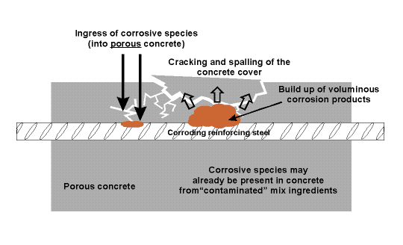
Corrosion Damage To The Reinforcing Steel- Schematic

Slide 27
How to Prevent Corrosion?
Quality Concrete
The first defense against
corrosion of steel in concrete is
quality concrete and sufficient concrete cover over the reinforcing bars.
Quality concrete has a
WATER-TO-CEMENTITIOUS MATERIAL RATIO (w/c)
that is low enough to
slow down the penetration of chloride salts and the development of carbonation.

Slide 28
Quality Concrete
The w/c ratio should be < 0.50 to slow the rate of carbonation
and
< 0.40 to minimize the
chloride penetration.

Slide 29
Quality Concrete
Concretes with low w/c ratios
can be produced by
(1) Increasing the cement content
(2) Reducing the water content by using water reducers and super-plasticizers or
(3) Using larger amounts of fly ash, slag or other cementitious materials.
Additionally the use of concrete ingredients containing chlorides should be limited.
The ACI 318 Building codes provides limit on the maximum amount of
soluble chlorides in the concrete mix.

Slide 30
Quality Concrete
Another ingredient for good quality concrete is
AIR ENTRAINMENT.
It is necessary to protect the concrete from freezing and thawing damage.
Air entrainment also reduces bleeding and corresponding increased permeability due to the bleed channels.
Spalling and scaling can accelerate corrosion damage of the embedded reinforcing bars.
Proper scheduling of finishing operations is needed to ensure that the concrete does not scale, spall, or crack excessively.

Slide 31
Correct Amount of Steel
The correct amount of steel will help keep cracks tight.
ACI 224 helps the design engineer to minimize the formation of cracks that could be detrimental to embedded steel.
In general, the maximum allowable crack widths are
0.007” in deicing salt environments and
0.006” in marine environments.

Slide 32
Cover Over Reinforcing Steel
Adequate cover over reinforcing steel is also an important factor.
Chloride penetration and carbonation will occur in the outer surface of even low permeability concretes.
Increasing the cover will delay the onset of corrosion.
For example,
The time of chloride ions to reach a steel rebar in 2 inches from the surface is four times that with a one inch cover

Slide 33
Cover Over Reinforcing Steel
ACI 318 recommends a minimum of 1.5 inch of cover of most structures, and increases to 2 inches of cover for protection from deicing salts.
ACI 357 recommends 2.5 inches of minimum cover in marine environments.

Slide 34
Cover Over Reinforcing Steel
Larger aggregates require more cover.
For aggregates greater than ¾, a rule of thumb is to add to the nominal maximum aggregate size ¾ inch of cover for deicing salt exposure, or
1¾ inch of cover for marine exposure.
For example,
concrete with 1 inch aggregate in a marine exposure should have a 2¾ inch minimum cover

Slide 35
Cured Concrete
The concrete must be adequately
consolidated and cured.
Moist curing for a minimum of seven days at
70º F is needed for concrete with a 0.40 w/c ratio,
whereas six months is needed for a 0.60 w/c to obtain equivalent performance.
Numerous studies show that concrete porosity is reduced significantly with increased curing times and, correspondingly, corrosion resistance improved.

Slide 36
Protection Techniques
Other protection techniques include:
Protective membrane,
Cathodic protection,
Epoxy-coated reinforcing bars, and
Concrete sealers,
if reapplied every four to five years.

Slide 37
How to Limit Corrosion?
Use good quality concrete – air entrained with a w/c ratio of 0.40 or less.
Use a minimum concrete cover of 1.5 inches and at least 0.75 inch larger than the nominal maximum size of the coarse aggregate.
Increase the minimum cover to 2 inches for deicing salt exposure and to 2.5 inches to marine exposure.
Ensure that the concrete is adequately cured.
Use fly-ash, blast-furnace slag and/or a proven corrosion inhibitor.

Slide 38
Calcium Chloride in Concrete – An Accelerator
In a chemical sense an over-all increase in the rate of reaction
In the physical sense an increase in the rate of setting
In a mechanical sense an increase in the rate of development of strength
From the practical point means reduction in the curing period and reduction in the time during which concrete must be protected in cold weather, earlier finishing operations, and earlier availability for use.

Slide 39
Accelerators for Concrete
Several chemicals are known to act as accelerators for concrete
Calcium Format,
Aluminum Chloride,
Potassium Carbonate,
Sodium Chloride and
Calcium Chloride
but Calcium Chloride is most widely used due to its ready availability, low cost, predictable performance characteristics, and successful application over several decades.

Slide 40
Chemical Effects on Concrete
If concrete is exposed to solutions of sulphates it may deteriorate
The sulphates react with calcium and aluminum ions in the cement paste to form
Calcium sulphate and
Calcium sulphoaluminate hydrates,
If calcium chloride is present, there is evidence that resistance to sulphate attack is reduced.
Thus, calcium chloride is not recommended for concrete exposed to sulphate attack.

Slide 41
Chemical Effects on Concrete
In well made, reinforced concrete, corrosion of steel is uncommon because in the alkaline environment a protective oxide film forms over the steel and makes it passive.
The film is stable only so long as a certain minimum pH is maintained.
In concrete containing calcium chloride, this stable film cannot be maintained with the same efficiency and a potential for corrosion exists.
For this reason precautions must be taken when calcium chloride is used in reinforced concrete:
ADEQUATE CONCRETE COVER
THOROUGH CONSOLIDATION

Slide 42
Chemical Effects on Concrete
Corrosion is critical in prestressed steel
because the surface area of the wires is large and stress differences are greater
Calcium chloride is therefore prohibited for prestressed concretes
It should not be used in concrete containing a combination of dissimilar metals or where there is a possibility that stray electric currents will be present.

Slide 43
Rebar Corrosion by Cl¯+ CO2
The main frequent cause of corrosion of reinforcement in concrete structure is
chloride attack and carbonation
:Chloride comes from several sources:
They can be cast in concrete
Diffuse into concrete as a result of sea salt spray
Direct seawater wetting.
Can diffuse into concrete due to chloride de-icing salts
The storage of chloride substances in concrete tanks and like wise.
The source of CARBONATION of concrete is atmosphere preferably in the areas of industrial and transport activities.

Slide 44
Rebar Corrosion by Cl¯+ CO2
Chlorides corrode
reinforcement in three ways:
(1) Chlorides to pass through the protective oxide film
(2) Adsorption of chlorides on the steel surface and thus promoting the hydration of metal ions and facilitating depassivation and
(3) It is supposed that chlorides are able to compete with hydroxyl ions for the ferrous ions produced by corrosion process.

Slide 45
Rebar Corrosion by Cl¯+ CO2
It is reported that a reduction in pH in concrete due to its carbonation will increase the severity of the attack in the presence of chlorides
The interactive effects of carbonation and chloride lead to much more rapid corrosion of reinforcement than where both the phenomena act separately
The effect is more pronounced
when the w/c ratio increases

Slide 46
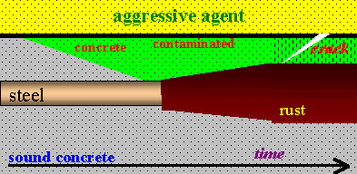
Stages of steel corrosion in concrete, induced by agents such as chlorides or the carbon dioxide. The aggressive agent penetrates in concrete cover, then initiates rust.
This rust grow and can crack the cover

Slide 47
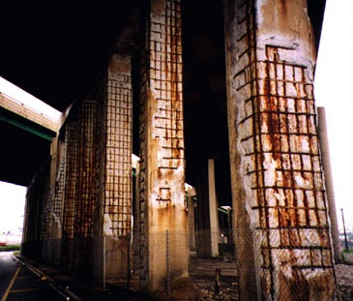
Selecting the appropriate level of corrosion protection is based on many factors such as the level of chloride contamination and carbonation, amount of concrete damage, location of corrosion activity (localized or widespread), the cost and design life of the corrosion protection system, and the expected service life of the structure.

Slide 48
Carbonation
Carbonation of concrete is a process by which carbon dioxide in the ambient air penetrates the concrete and reacts with the hydroxides & calcium carbonate is formed.
Carbonation may affect surface durability
Carbonation significantly lowers the alkalinity (pH) of the concrete.
High alkalinity is needed to protect embedded steel from corrosion; consequently, concrete should be resistant to carbonation to help
prevent steel corrosion

Slide 49
Carbonation
The amount of carbonation is significantly increased in
A high water to cementing materials ratio
Low cement content,
Short curing period,
Low strength, and
Highly permeable (porous) paste.
The depth of carbonation in good-quality, well-cured concrete is generally of little practical significance as long as embedded steel has adequate concrete cover.

Slide 50
Carbonation
Depending on the concrete properties,
Ingredients,
Age,
Environmental exposure,
Concrete with finished surfaces tend to have less carbonation than with formed surfaces.
Carbonation depth with
finished surfaces is to a depth of 1 to 10 mm and
for formed surfaces, between 2 to 20 mm after several years of exposure

Slide 51
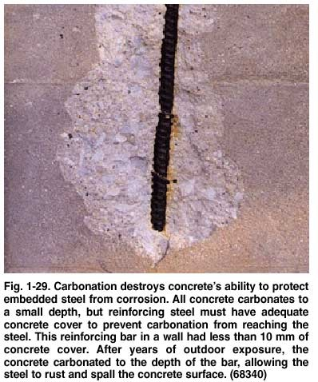

Carbonation destroys concrete’s ability to protect embedded steel from corrosion. All concrete carbonates to a small depth, but reinforcing steel must have adequate concrete cover to prevent carbonation from reaching the steel. This reinforcing bar in a wall had less than 10 mm of concrete cover. After years of exposure, the concrete carbonated to the depth of the bar, allowing the steel to rust and spall the concrete surface.

Slide 52
Carbonation
The depth of carbonation can be determined by Petrography Techniques
(ASTM C 856)
through the observation of calcium carbonate
A phenolphthalein colour test can be also be used to estimate the depth of carbonation by testing the pH of concrete (carbonation reduces pH).
Upon application of the phenolphthalein solution to a freshly fractured or freshly cut surface of concrete, noncarbonated areas turn red or while carbonated areas remain colourless
RED
PURPLE

Slide 53
Phenolphthalein Testing

Slide 54
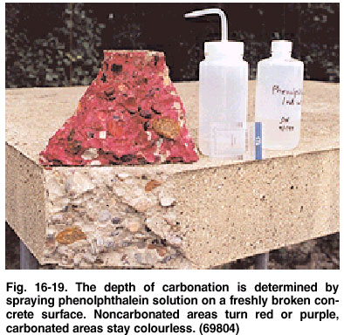
Phenolphthalein Testing

Slide 55
What is Carbonation?
Carbonation occurs in concrete because the calcium bearing phases present are attacked by carbon dioxide of the air and converted to calcium carbonate.
Cement paste contains 25-50 wt% calcium hydroxide, which means that the pH of the fresh cement paste is at least 12.5.
The pH of a fully carbonated paste is ~7.

Slide 56
What is Carbonation?
The concrete will carbonate if CO2 from air or from water enters the concrete according to:
Ca (OH)2 + CO2 → CaCO3 + H2O
The carbonation process requires the presence of water because CO2 dissolves in water and forms H2CO3.
If the concrete is too dry (RH <40%) CO2 cannot dissolve and no carbonation occurs.
If on the other hand it is too wet (RH >90%) CO2 cannot enter the concrete and the concrete will not carbonate.
Optimal conditions for carbonation is
RH of 50% (range 40-90%).

Slide 57
What is Carbonation?
Normal carbonation results in a decrease of the porosity making the carbonated paste stronger.
Carbonation is therefore an advantage in non-reinforced concrete.
However
It is a disadvantage in reinforced concrete, as pH of carbonated concrete drops to about 7
- a value below the passivation threshold of steel.

Slide 58
How to Recognize Carbonation?
Carbonation may be recognized in the field by the presence of a discolored zone in the surface of the concrete.
The colour may be light gray. Carbonation can be visualized by using phenolphthalein.
In the optical microscope carbonation is recognized by the presence of calcite crystals and the absence of calcium hydroxide, ettringite and un-hydrated cement grains.
Porosity is unchanged or lower in the carbonated zone.

Slide 59
Bi-carbonation - What is That?
Occasionally concrete may suffer from the so called
bi-carbonation process.
Bi-carbonation may occur in concrete with very high water to cement ratio at pH lower than 10.
Contrary to normal carbonation, bi-carbonation results in an increase in porosity making the concrete soft and friable.
Bi-carbonation may be recognized by the presence of large ‘Pop-Corn’ like calcite crystals and the
highly porous paste

Slide 60
Corrosion Control in Concrete
The control methods can be divided into two major areas
Corrosion control in new concrete construction
Corrosion control for rehabilitation of existing concrete structures

Slide 61
Corrosion Control in Concrete
The use of
Good construction design and procedures
Adequate concrete cover depth,
Corrosion-inhibiting admixture, and
Low-permeability concrete
alone will not abate the problem
because concrete has a tendency to crack inordinately
Even corrosion-inhibiting admixture for concrete would likely not be of use when the concrete cracked.
This situation essentially leaves the reinforcing steel itself as the last line of defense against corrosion.

Slide 62
Use of a Barrier System
The use of a barrier system on the reinforcing steel:
such as Epoxy Coating or
other Organic or even other possible
Metallic Coatings-
is even more critical in abating this
costly corrosion problem

Slide 63
Embedded Epoxy-coated
Steel Bars
Many successful performances of embedded epoxy-coated steel bars in different projects indicate that
When used in exposure conditions that
do not keep the concrete constantly wet
the epoxy coating will provide a
certain degree of protection to the steel bars and thereby
delay the initiation of corrosion.

Slide 64
Cathodic Protection
For existing chloride-contaminated concrete bridge decks
impressed-current Cathodic Protection
-using titanium mesh anodes-
provides the ultimate and permanent solution to stop rebars corrosion in the structures:
as long as associated rectifiers and electrical wiring are properly maintained.

Slide 65
Electrochemical
Chloride Extraction
Electrochemical chloride extraction
provides an alternative rehabilitation method for stopping steel corrosion in contaminated concrete - though less permanently.
This alternative has the advantage of having no rectifier or wiring to maintain after the treatment.

Slide 66
Electrochemical Chloride Extraction (ECE) from
Salt Contaminated Concrete

Slide 67
Electrochemical Chloride Extraction (ECE) from
Salt Contaminated Concrete

Slide 68
Electrochemical Chloride Extraction (ECE) from
Salt Contaminated Concrete

Slide 69
Patch-accelerated Corrosion
When concrete delaminations are repaired using typical ‘chip and patch’ procedures, abrupt changes in the concrete chemistry surrounding the reinforcing steel are created.

Slide 70
Patch-accelerated Corrosion
Typical repair procedures call for removal of the contaminated concrete
around the full circumference of the
reinforcing steel
within the repair area, cleaning of
bond-inhibiting corrosion by- products
from the steel, and refilling the cavity with new chloride-free, high-pH concrete
(ICRI Guideline No. 03730).

Slide 71
Patch-accelerated Corrosion
In the case of chloride-induced corrosion,
this procedure creates adjacent
Chloride contaminated -
Chloride free zones
with significantly different corrosion potentials
This difference in corrosion potential (voltage)
is the DRIVING FORCE for new corrosion sites to form in the surrounding
chloride-contaminated concrete.

Slide 72
Patch Accelerated Corrosion in Concrete

Slide 73
Embedded Galvanic Anode Installed In Patch Repair For Protection Against Patch Accelerated Corrosion Initiation

Slide 74
Ring-anode Corrosion
The new corrosion activity is commonly referred to as
        RING-ANODE CORROSION
        HALO EFFECT
        INCIPIENT ANODE FORMATION
Once again, from a practical standpoint, the evidence of this activity can be new concrete spalls adjacent to the previously completed patches.
The time between repair programme will be influenced mainly by the amount of
chloride present and the conductivity of the concrete
It is common to find additional repairs required
in 2 to 5 years.

Slide 75
Anodic Ring Damage

Slide 76
Anodic Ring (Halo Effect)
Anodic ring phenomena are associated with a repair area that is surrounded by ‘new’ corrosion sites
Anodic ring phenomena are one of the primary reasons for short-lived repairs

Slide 77
Corrosion Management Strategy
Developing a corrosion management strategy will depend on many factors, like:
The amount of existing damage,
Level of contamination,
Environmental exposure,
The owner’s requirements,
Budget.
In many cases, longer-term corrosion solutions may be considered.

Slide 78
Corrosion Service Life

Slide 79
Corrosion Mitigation Strategies
    Removal and replacement
    Barrier systems
    Electrochemical treatments
    Impressed current cathodic protection

Slide 80
Removal and Replacement
Widespread removal of chloride-contaminated or carbonated concrete is a Long-term Solution
This approach lends itself to structure with severe corrosion problems as evidenced by a large percentage of the surface area being delaminated.
This option is
        Cost-prohibitive or
        Impractical in many situations
Removal and replacement can also create structural shoring requirements and increased costs.

Slide 81
Barrier systems
The use of
        Sealers
        Coatings
        Overlays
are often considered for
mitigating future corrosion activity
Barrier systems operate by preventing the
        Ingress of chloride ions,
        Moisture,
        Carbon Dioxide
into the structure.

Slide 82
Barrier systems
If the structure is already contaminated and showing signs of corrosion distress
the use of barrier system will generally have a limited impact on the service of the structure.

Slide 83
Electrochemical Treatments
An electrochemical approach to achieve long-term corrosion protection is to address the underlying cause of corrosion without the widespread removal of contaminated but sound concrete
For many projects, electrochemical treatments are a cost-effective strategy for providing corrosion protection over large areas.

Slide 84
Electrochemical Chloride Extraction (ECE)
It is a short-term process where electric field is applied between the reinforcement in the concrete and an externally mounted mesh.
The mesh is embedded in a conductive media, generally a sprayed-on mixture of potable water and cellulose fibre for vertical and overhead surfaces.
During treatment, negatively charged chloride ions are transported away from the rebar and toward the positively charged external electrode mesh by means of ion migration, where they are trapped and removed in the fibrous electrolyte mixture

Slide 85
Electrochemical Chloride Extraction for Re-alkalization
For structure subject to carbonation-induced corrosion, a variation of the ECE process can be utilized to re-alkalize (increase the pH of) the concrete
The primary differences between
ECE and Re-alkalization are:
        The choice of the electrolyte
        The duration of treatment and
        The procedures to verify a successful application.

Slide 86
Realkalization

Slide 87
Realkalization

Slide 88
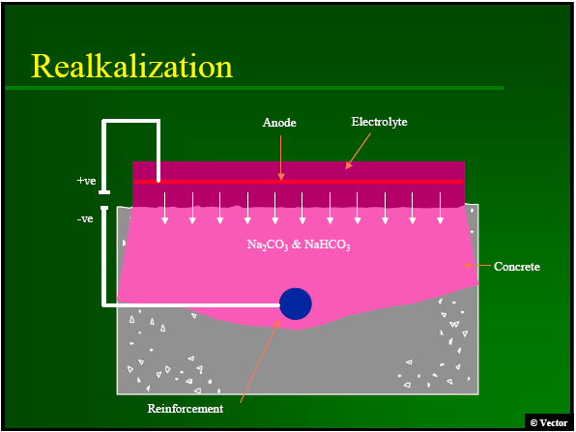
Realkalization

Slide 89
Impressed Current Cathodic Protection (ICCP)
ICCP systems start with the installation of permanent anode(s) into the structure.
An external DC power source is applied with the anode being connected to the positive (+) terminal and the reinforcing steel connected to the negative (-) terminal.
Properly designed, installed, and maintained, ICCP system can provide long-term protection to the reinforcing steel.

Slide 90
Impressed Current Cathodic Protection (ICCP)
ICCP systems can be cost-effective when used to protect large areas, and the initial costs are spread over a long period of time
Periodic inspection and maintenance of the system is required
If an on-going monitoring and maintenance of the system is unlikely - other corrosion mitigation strategies should be considered

Slide 91
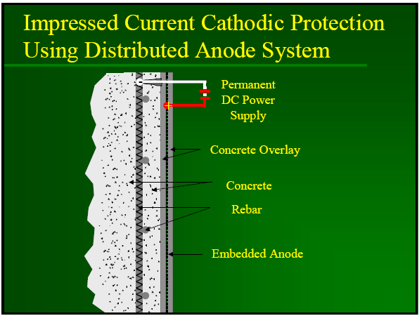
Impressed Current Cathodic Protection

Slide 92
Galvanic Protection
Galvanic protection is achieved when two dissimilar metals are connected
The metal with the higher potential for corrosion (generally a zinc-based system in concrete applications) will corrode in preference to the more noble metal
As the sacrificial metal corrodes, it generates electrical current to protect the reinforcing steel

Slide 93
Galvanic Protection
Potential applications for galvanic systems include walkways, bridge and parking decks, and pre-cast/prestressed concrete
Two types of galvanic protection systems are used for these applications:
        Distribution system for global corrosion protection
        Discrete anodes for localized protection

Slide 94
Galvanic Protection
DISTRIBUTED SYSTEMS
consist of galvanic anode(s) that are placed onto the surface of the concrete or embedded in a concrete overlay
DISCRETE SYSTEMS
Utilize Embedded Galvanic Anodes (EGAs) tied to the steel which is exposed in the area to be repaired.
EGAs can also be used to protect the remaining concrete by installing into drilled holes on a grid pattern.

Slide 95
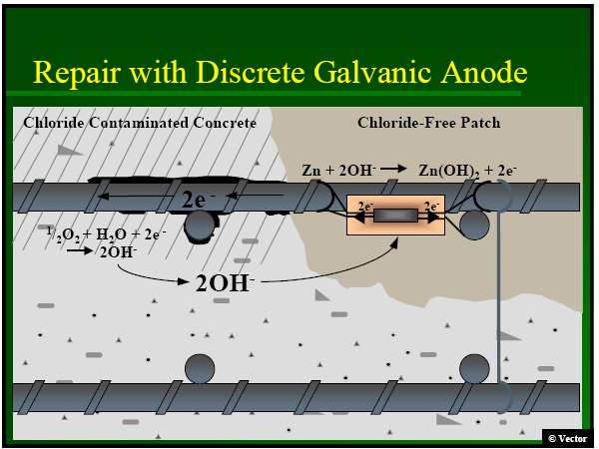
Repair with Discrete Galvanic Anode

Slide 96
Discrete Galvanic Anode Installed in Sound Concrete

Slide 97
Galvanic Protection
To address patch-accelerated corrosion, palm-sized EGAs are used in conjunction with traditional concrete repair by tying the anodes onto the reinforcing steel at perimeter of concrete patches
Once the concrete is placed, the zinc anodes provide localized galvanic protection to prevent corrosion initiation of the adjacent reinforcing steel

Slide 98
Magnitude of The Rebar Corrosion Problems
It was recognized by the mid 1970s that the corrosion of concrete structures was caused by the corrosion of the reinforcing steel in the concrete was induced by the intrusion of even a small amount of chloride into the concrete

Slide 99
Magnitude of The Rebar Corrosion Problems
ACCORDING TO A 1997 REPORT
of the 581,862 bridges in and off the U.S.A. federal-aid system
~101,518 bridges were rated as
structurally deficient
Most of these bridges were not in danger of collapse but they were likely to be load posted so that overweight trucks will be required to take a
Longer Alternative Route

Slide 100
Magnitude of The Rebar Corrosion Problems
The estimated cost to eliminate all backlog bridge deficiencies was approximately $78 billions, and it could increase to as much as $112 billions…..
The average annual cost, through year 2011, for just maintaining the overall bridge conditions, was estimated to be $5.2 billions
While corrosion of the reinforcing steel was not the sole cause of all structural deficiencies, it was a significant contributor and has therefore becomes a matter of major concern

Slide 101
Cost Impact Pay-Off by (ECR)
Epoxy-Coated Rebars (ECR)
Cost Impact
Cost and Benefits are always important factors to consider in any project under consideration to make the project viable and productive.
The delivered on-site cost of uncoated black steel
$ 0.44/kg and ECR was $0.62/kg.
The cost associated with using the different rebars and the total costs of the decks, it is evident that the cost of decks constructed with epoxy-coated rebars averages about 1 % more than if constructed with black steel.

Slide 102
Costs of Bars and Decks
Deck | Cost of Bars ($) | Cost of Bars ($) | Cost of Deck ($) | Cost of Deck ($)
- | Black Steel | Epoxy-Coated | Black Steel | Epoxy-Coated
A | 21,644 | 30,302 | 690,000 | 698,658
B | 22,544 | 31,561 | 880,000 | 899,017
C | 13,614 | 19,059 | 1,122,000 | 1,127,445

Slide 103
Potential Pay-off
The potential pay-off can be estimated conservatively on the basis that the ECR will provide at least twice the corrosion-free service life ‘built with black steel’ –
e.g. On the federal-aid highway system in US, there are about 2.3 B Ft² of deck surface.
So far, ECR has been used on only 100 M Ft² of deck. Based upon the average
replacement cost of $40/ Ft² for bridge deck
The potential savings are:
$40/ Ft² x 100,000,000 Ft² = $4 billion in 50 years
or earlier

Slide 104
Potential Pay-off
Considering that eventually the remaining decks built with black steel will need replacement, the estimated future savings on the decks will be:
$40/ Ft² x 2,200,000,000 Ft² = $88 B
in that same amount of time.

Slide 105
Early Detection of Steel Rebar Corrosion
Two commonly used inspection methods for determining concrete rebar condition are
Visual Observation and
Half-Cell Potential Measurements

Slide 106
Visual Observation
Visual observation uses direct or remote inspection to detect obvious signs of corrosion, such as physical damage in the form of spalling or cracking
Visual observation can range from cursory examination to detailed mapping of the surface.

Slide 107
Visual Observation
Core sampling is often performed if the visual observation suggests that further evidence is needed.
Visual observation is subjective and provides corrosion detection only after significant corrosion has occurred.
Core sampling is destructive and requires repair of the concrete.

Slide 108
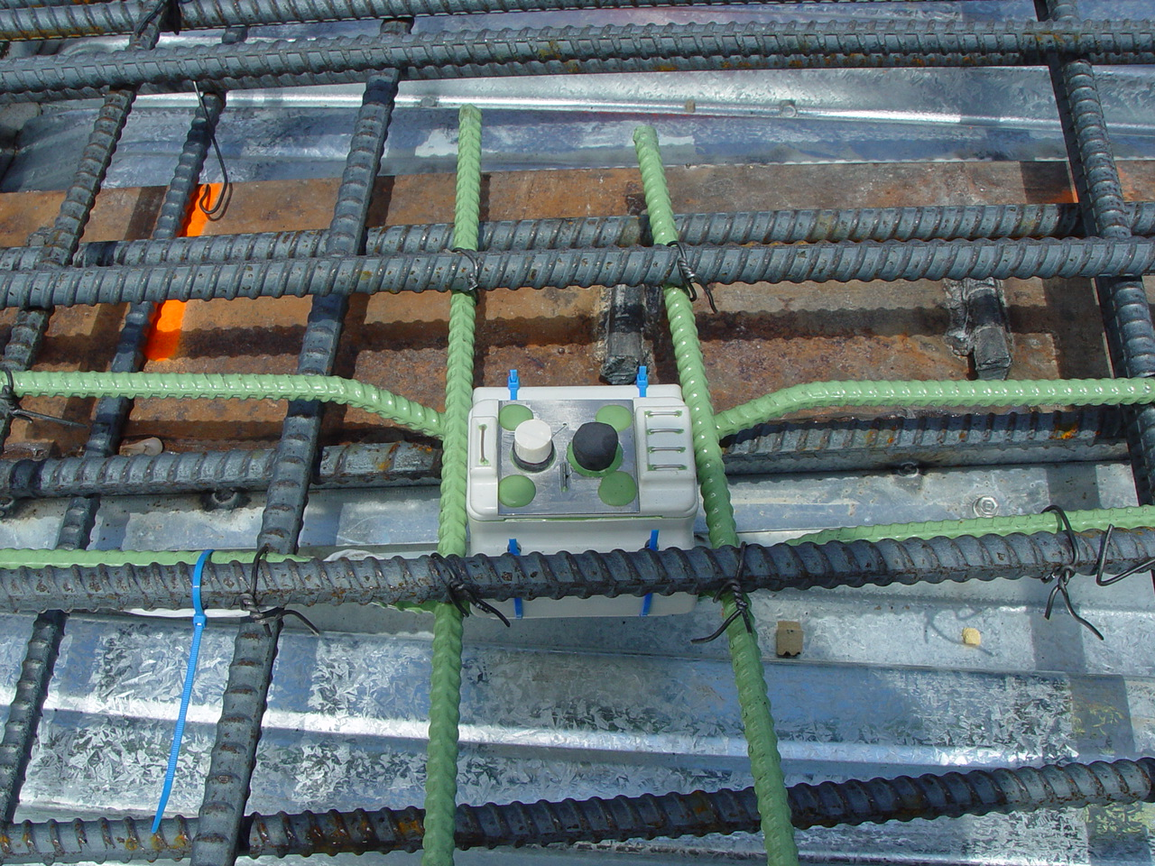
Corrosion Monitoring Device

Slide 109
Causes of Deterioration of Concrete

Slide 110
Careful Selection and Specification of Material

Slide 111
Environmental Influences

Slide 112
Lack of Maintenance & Poor Repair

Slide 113
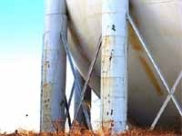
View of deteriorated cementitious fireproofing placed over structural steel pipe columns. Rust corrosion product staining emerging from concrete cracking is visible, but how bad the structural steel losses are is not known

Slide 114
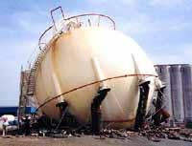
View of failed sphere support columns, severely corroded and unseen below a painted cementitious fireproofing system, note extensive structural steel section losses due to embedded metal corrosion

